Slide 1





Origin of the creative idea
The idea came from exploring clean and modern form designs often used on professional websites. We wanted a layout that felt user-friendly, with soft colors, clear spacing, and an inviting visual style to make the form easy and pleasant to use.
We chose a gradient background, smooth corners, and minimalist fields to give it a polished look. Our goal was to blend functionality with simplicity so users could focus on inputting their event details without distractions.

Slide 2




To create a simple, modern event management app that allows users to easily add, view, and update event details on any device.
01.
Project vision and mission
To provide a user-friendly interface with smooth navigation, ensuring a seamless experience for organizing and managing events.
02.
To help users save time and effort by centralizing event creation, editing, and tracking into one clean and responsive platform.
03.

Slide 3

Inspiration and creativity
The inspiration behind the project came from the everyday challenges people face when trying to organize or keep track of events. We wanted to simplify this process by creating an app that’s not only functional but also visually appealing. Our creativity shows through in the clean layout, interactive cards, and intuitive navigation that make managing events both easy and enjoyable.

Slide 4

Ideation process
01
02
03
04
Problem Identification: We recognized the difficulty many users face in managing personal or group events efficiently.
User-Centric Brainstorming: We listed essential features like adding, updating, deleting, and listing events based on user needs.
Wireframing & Design: We created mockups to visualize layout, navigation, and UI/UX consistency across pages.
Feedback & Refinement: We tested early versions, gathered feedback, and refined both functionality and visual design for better usability.

Slide 5
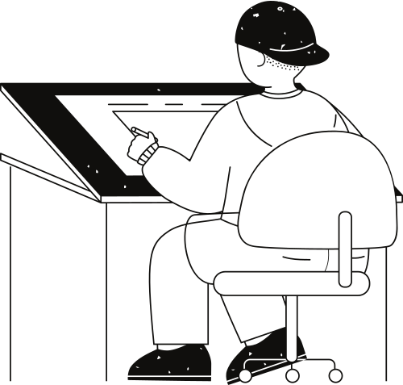





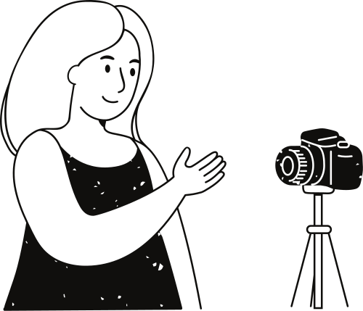
Add, Update, and Delete Events
Responsive UI with Ionic and Angular
Key Features
Search and Filter functionality
Footer navigation across all pages
Backend with ExpressJS and MongoDB
Preloaded Sample Data from JSON File

Slide 6



95%
Positive User Feedback
Our Event Management System has received overwhelmingly positive feedback from users and testers alike. With its intuitive interface, smooth performance, and powerful features like live event updates and secure data handling, it has become a reliable tool for managing events effectively.

Slide 7

Weaknesses
Threats
Currently lacks user authentication and role-based access.
Limited testing on large-scale data.
Design may require more accessibility considerations.
Security vulnerabilities without proper login/auth.
Similar apps exist with advanced features.
Backend downtime could affect user trust.
Strengths
Opportunities
Our app is easy to use, visually appealing, and mobile-friendly.
It features powerful event CRUD and search tools.
Backend integration ensures real-time performance.
Can be expanded to support ticketing and user registration.
Potential to integrate with calendars and payment gateways.
Open-source scalability offers future growth.

Slide 8
Thank you very much!

